Slide 1
Revision 1.0
Client
Server
Test Artefacts
Function Artefacts
UI
Manual Creation
Automatic Generation
In house IDE
Support PGL
Database

Slide 2
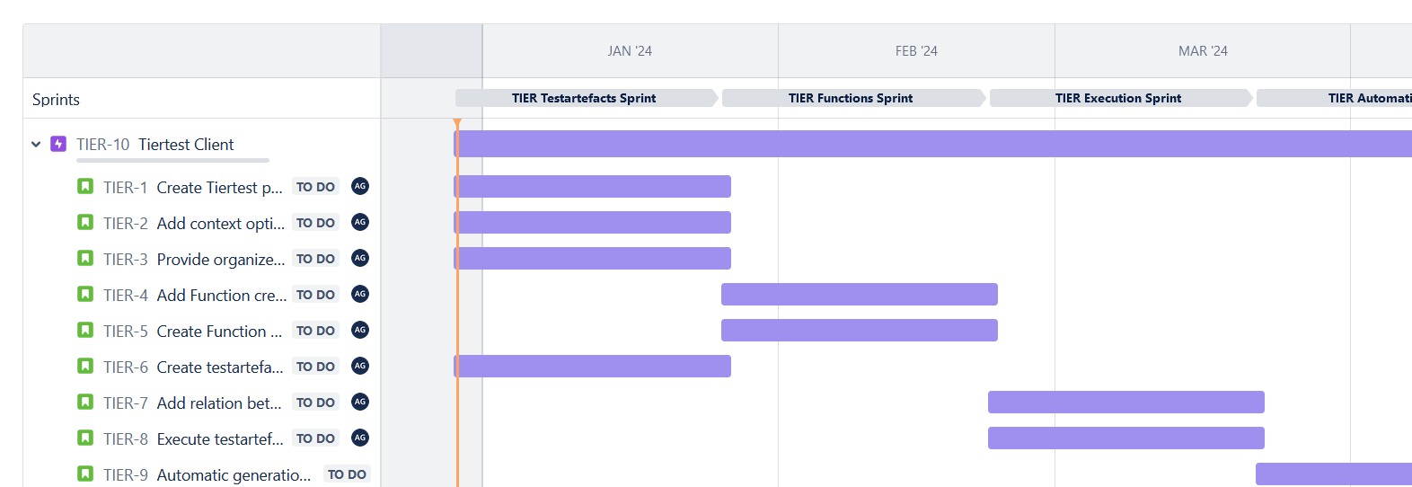
Revision 1.0

